Slide 1


A Move Toward Agile APM:
Application Performance Management
Frank Ober, Performance Engineer
June 2012
Notes:
I live in the agile and non-agile world
APM to me at the first responder level for applications, means E2E visibility, and it starts with an application server agent tool.
Our agile side, is automated, automated as a Platform as a Service Model,
Application Servers that are instrumented for the Web Page Lifecycle, and make provide full E2E views for the Service or DevOps Team.
Management Gets it, the see the agility of cases where they are finding the tier when you are looking E2E makes sense for key applications.
Management is infatuated now with User Experience and the need to manage the real user experience.
Finally how we are set up is key. To the breadth and completeness, we have Network Engineering and Cloud Engineering working as one program to solve these first responder problems that the silo’s face.
So what are some key directions to build upon to make APM work better.

Slide 2
Architectural Maps
WS1
40ms
WS2
Automation
App
Server
WS3
WS4
WS5
400ms
Notes:
We will move this to the Design and Architecture phase, in Architecture and Design this is where you want to be pro-active so your APM is less of a triage platform and more of an optimization platform. You start to feel better when you figure out high performance in a better part of the software lifecycle.

Slide 3
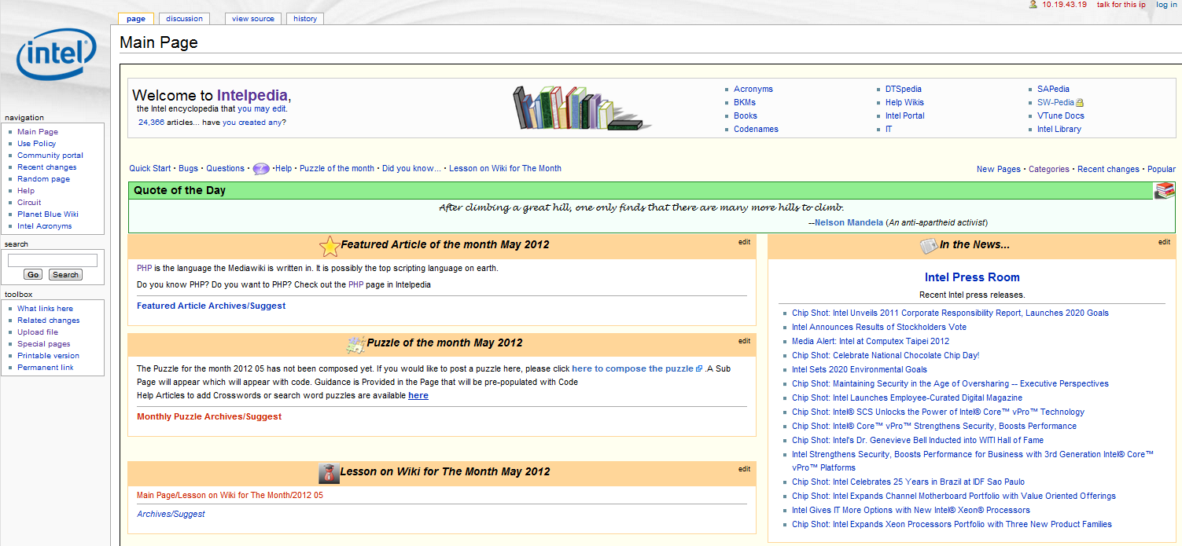
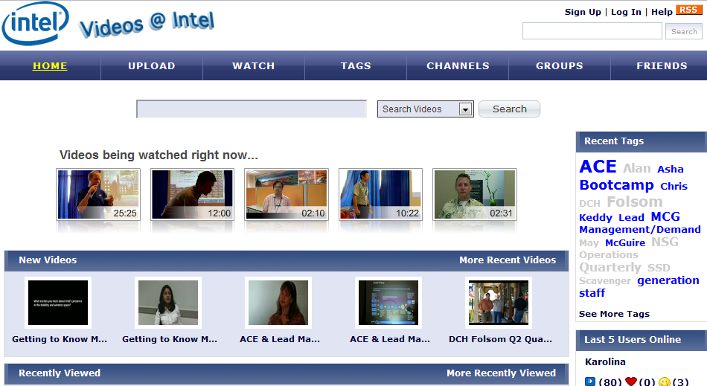
Train, Train, Train
Notes:
The story of Intel’s Open Source Caching Strategy….and how we are moving that story into a training agenda.

Slide 4
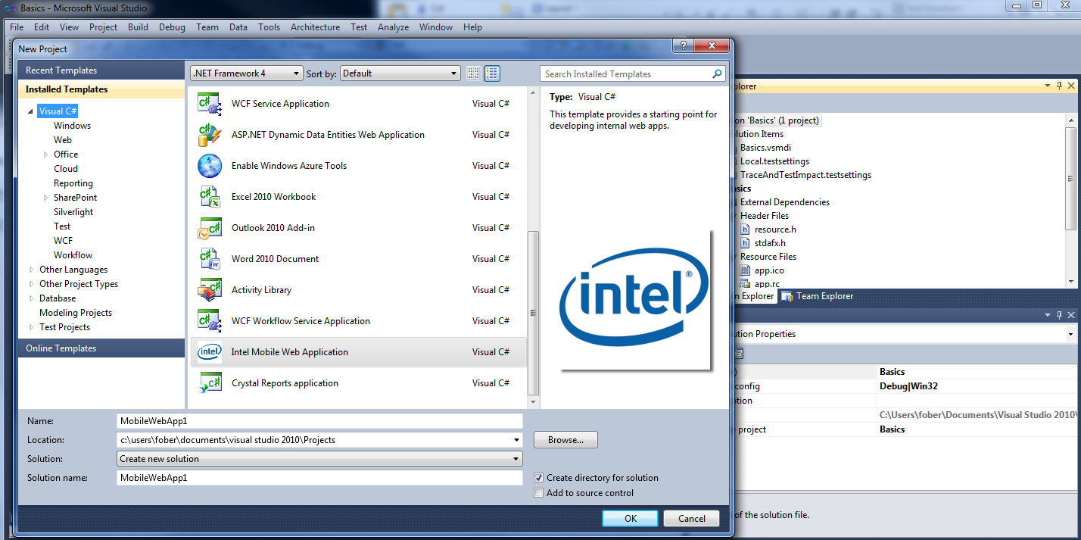
RUM those Templates
Notes:
Templates need to have timers in them… they may get auto-instrumented but in a fractured world they may not, you need to be pro-active and work on this and again head this off, so the productive implementation of APM is as rich as possible. .NET may be easier to get RUM working, in Mobile or Java less so. Also figure out a priority scheme based on your core APM program goals, and deliver end user monitoring as the total E2E solution there first.
TO hear more of my perspectives on APM please come to my session 1pm Ballroom E, I have some Intel goodies, namely enthusiast level SSD’s to give out to those that remember some key takeaways about APM.
☺

Slide 5

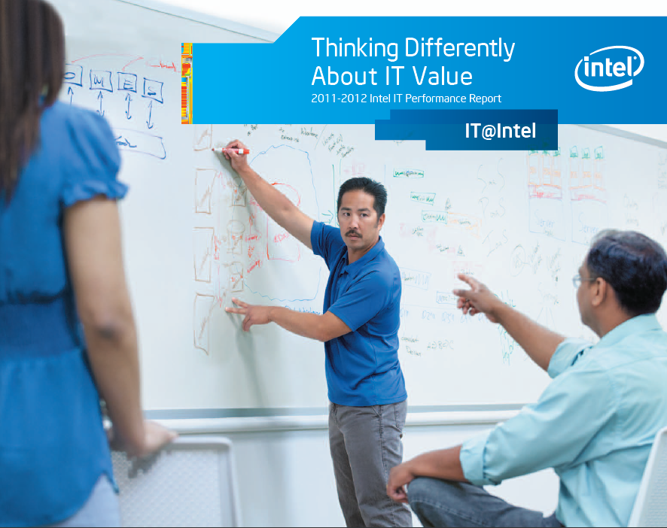
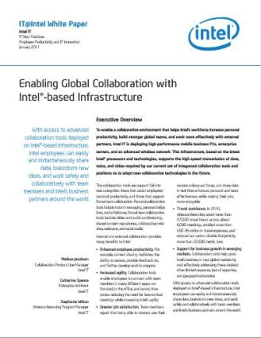
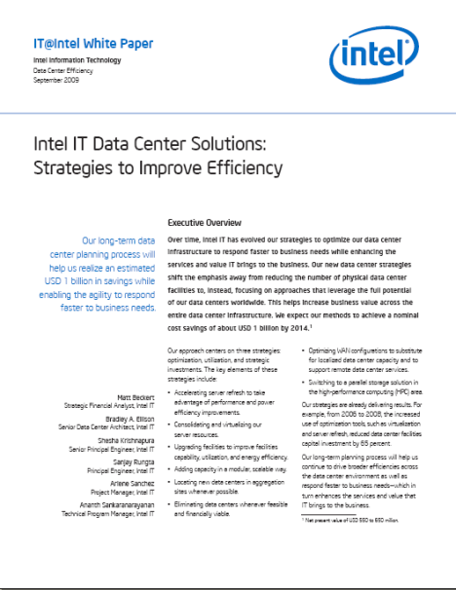

Sharing Intel IT Best Practices with the World
Learn more about Intel IT’s Initiatives at www.intel.com/IT
Notes:
Slide purpose: Promote the IT@Intel program; Drive audience to intel.com/it
With that, what I’d like to do is leave you with the ability to get more information about what Intel IT is doing about these subjects.
Check out our website at intel.com/IT where you’ll find white papers, videos, radio shows, interviews with our senior IT leaders, and much more … on topics ranging from data center management and mobility, to
explore and engage with us as we try to drive business value inside of our organizations and share that with each other, so we can all move forward faster.
Thank you.

Slide 6
Legal Notices
This presentation is for informational purposes only. INTEL MAKES NO WARRANTIES, EXPRESS OR IMPLIED, IN THIS SUMMARY.
Intel and the Intel logo are trademarks of Intel Corporation in the U.S. and/or other countries.]
* Other names and brands may be claimed as the property of others.
Copyright © 2012, Intel Corporation. All rights reserved.
Notes:
6

